Slide 1
Speech CLASSIFICATION using adaboost
Abhishek Vasu (av1912)
Priyanka Mohandas (pm2641)

Slide 2
Aim
To detect the word that is being spoken.
We classify between two words – Bread and Anything

Slide 3
System description
The system performs two major functions
Feature extraction
Classification

Slide 4
Feature Extraction
Every speech signal has a set of unique features
Classification is done on the features
MFCC is used in this project

Slide 5
Mel Frequency Cepstral Coefficient
MFCC makes use of filter banks to accurately extract as much useful signal as possible
Mel frequency scaling –close to human auditory system

Slide 6
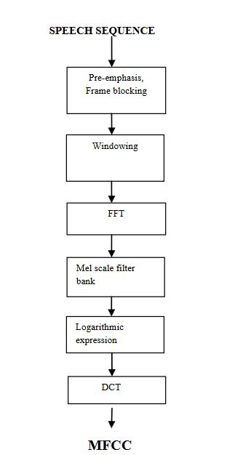

Slide 7
AdaBoost
Boosting - ensemble method that creates a strong classifier from a number of weak classifiers.
Weak classifier - slightly correlated to true classification
Strong classifier – well –correlated to true classification
AdaBoost [Adaptive Boosting] – binary classification
Adaptive - subsequent weak learners are tweaked in favour of those instances misclassified by previous classifiers

Slide 8
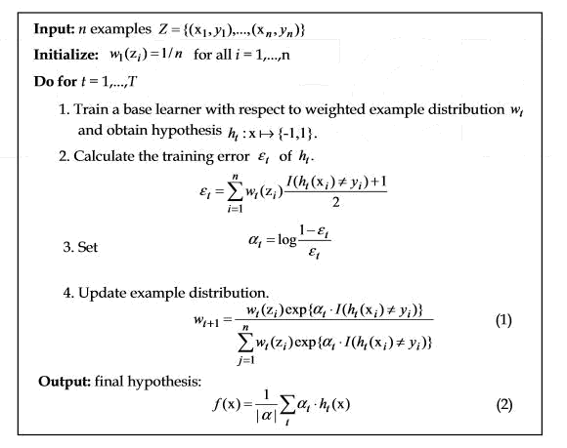

Slide 9
Python Implementation
sklearn.ensemble.AdaBoostClassifier(base_estimator=None, n_estimators=50, learning_rate=1.0, algorithm='SAMME.R', random_state=None)
base_estimator - from which the boosting ensemble is built
n_estimators - maximum number of estimators at which boosting is terminated

Slide 10
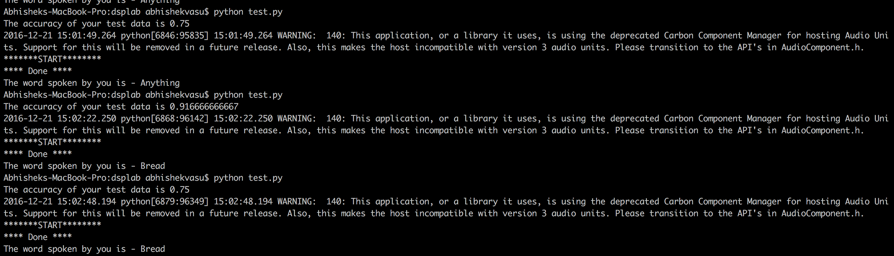
Result

